Slide 1
Welcome to Fourth Grade!
2023-2024
Mrs. Koch, Mrs. Williams,
Mr. Warren

Slide 2
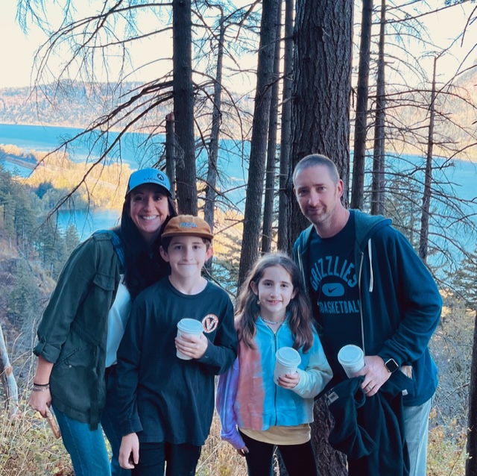
Mrs. Koch
•21 years at Richland Elementary
•Bachelor’s in Human Development
•Masters in Curriculum and Instruction
•National Board Certification-2010 and 2020
•I have a son in 5th grade and a daughter in 3rd

Slide 3
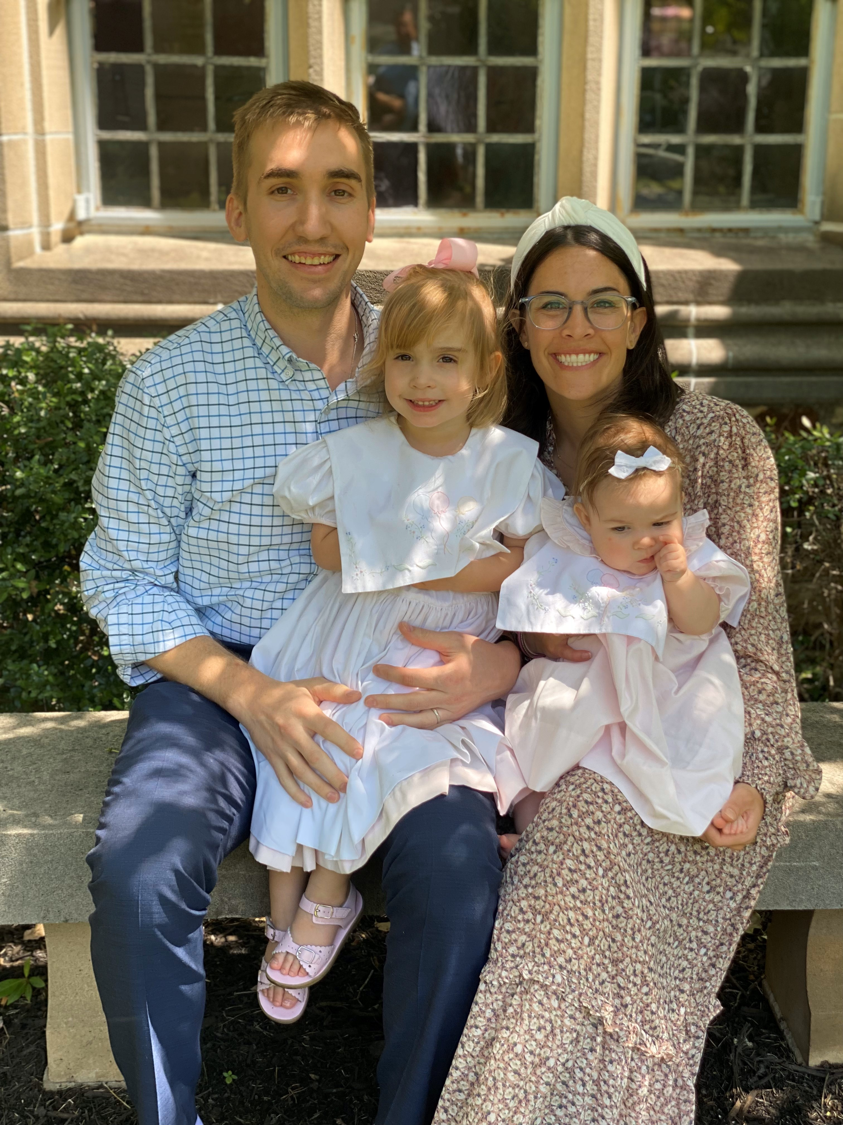
Mrs. Williams
-I am starting my 11th year in education
-Alumni of the University of Memphis (Go Tigers!!)
Teaching All Learners, Master's in ICL Reading Specialists
-I have two daughters, Kate and Emily

Slide 4
Mr. Warren
This year will be my 11th year teaching.
First year at Richland
Attended University of Louisville and Georgia State University
My wife and I have two young daughters including a first grader at Richland.

Slide 5
Weekly Communication
Newsletters containing lessons for each subject will be posted on our websites by Friday afternoons. Each website will contain the SAME newsletter.
Newsletters can be found under “Updates” on each webpage.
You can access all teacher webpages through Richland Elementary’s homepage.
IMPERATIVE: Please ensure you have a working email address in PowerSchool. Reach out ASAP if it is not current.

Slide 6
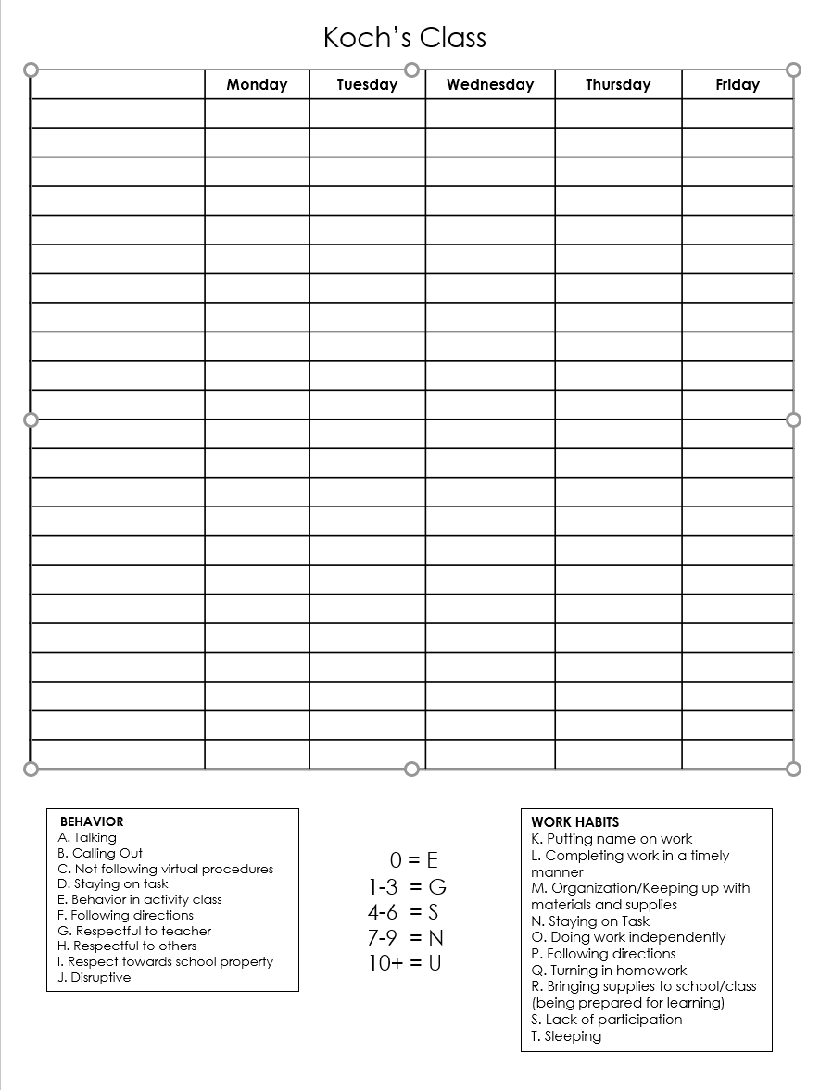
Behavior
We will follow SCS and Richland behavior guidelines.
We monitor classroom behavior daily. We use a clipboard that follows students to each class. We can then notify you if there is a behavior issue that occurs during the day.
The following chart will allow us to keep track of conduct/work habits throughout the quarter.

Slide 7
Attendance/Tardies/School Hours
School Hours: 8:15-3:15
If your child is going to be absent for several days, please let us know so that we can gather make up work. We will need ample notice to gather materials.
When your child returns to school, please send an excuse note/doctor note.
Make up work is the responsibility of the student!
Dismissal: Please pick up your child at 3:15. We often have meetings scheduled at 3:30 that we must attend.

Slide 8
4th grade Schedule
Tuesday will follow a modified schedule due to teacher planning.
RECESS occurs during the last 20 minutes of Sci/SS.
We will operate on an AA/BB schedule. See homeroom websites for specifics on schedules.
ENCORE: Varies by teacher
8:00-8:15: Good Morning (Homeroom check in)
8:15-9:00: BOOST
9:05-10:35: Block 1
10:35-11:25: ENCORE
11:30-1:00: Block 2
1:00-1:30: LUNCH
1:35-3:00: Block 3

Slide 9
SNACKS
Due to our late lunch, students may bring a healthy snack! (DRY)
Goldfish, pretzels, string cheese, apple sauce pouch, etc.
PTO has purchased water stations for our building! Thank you, PTO!!!
Be sure to pack water each day!

Slide 10
Conferences
Email: If your concern is minimal, you are welcome to email at any time. We will respond within 24 hours.
kochlf@scsk12.org
williamsl27@scsk12.org
warrenrb@scsk12.org
Please be mindful that emailing about an assignment at 7-8 pm may not receive a response prior to the next day.
Conferences can be held virtually or in person. We are generally available in the mornings (10:35-11:15), except Tuesdays.
Dependent upon schedules, after school meetings may take place.
If your concern is specific to reading, please contact Mrs. Williams. Likewise, if your concern is specific to science/social studies, reach out to Mr. Warren, etc.
We are happy to schedule conferences with you when you have a concern to discuss. You do not need to wait until parent-teacher conference night.

Slide 11
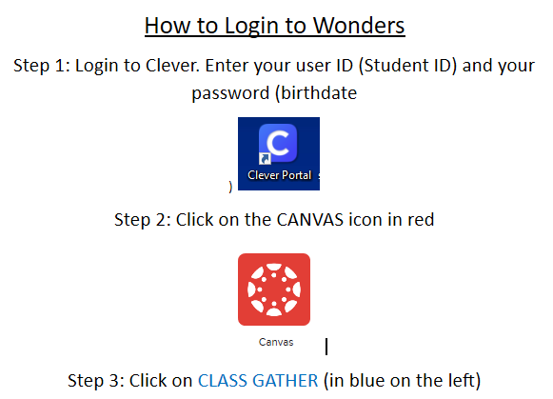
Curriculum: WONDERS
-Almost all assignments will be completed through the Wonder’s Portal. To access the text, spelling, or any extra assignments, follow the steps below to login.

Slide 12
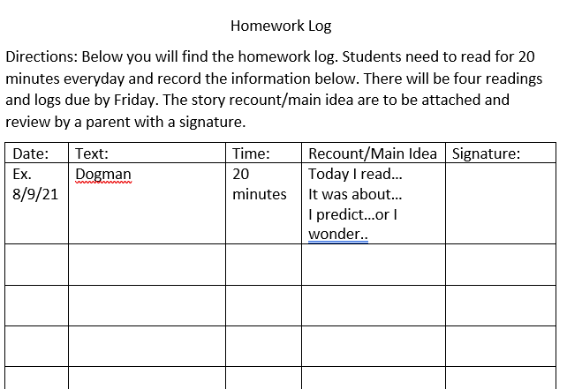
Reading Log

Slide 13
Curriculum: Envision Math
Math content will be taught based on TN State Standards. I will use Envision Math, parts of Eureka math, and teacher created resources to guide instruction.
Please be mindful of negative perceptions/attitudes surrounding math. It is most observed by children and they carry it into the classroom. Every child has enormous potential and we need to do everything to maximize it!

Slide 14
Math Facts
I give a math facts quiz every Friday. It will have 20 problems and students will have 2 minutes. We will begin with the 2x math facts, then move to the 3x facts, and so on….
Math facts will be entered as project/portfolio grades which only account for 5% of the final average.
Students with 504s/IEPs will be given time and a half as noted in the plans. (if deemed necessary!)
BASIC NECESSITY in math: EXPO marker!!! These do not last all year and we will use them EVERY.SINGLE.DAY.

Slide 15
SCS Grading Policy
Homework: 5% (minimum four grades)
Class Participation: 5% (minimum four grades)
Classwork: 40% (minimum four grades)
Projects, portfolios, or presentations: 5% (minimum one grade)
Tests: 45% (minimum four grades)
10 point grading scale

Slide 16
Science/Social Studies
Weekly quiz
Writing in Social Studies
Homework- will only be sent if classwork is unfinished or student has makeup work.
Research!

Slide 17
Homework
Homework is a required category in SCS grading policy. We must include a minimum of 4 homework grades per quarter. Homework comprises 5% of the final average.
Homework is graded for completion, not accuracy.

Slide 18
Viewing Grades
PowerSchool is available to all parents. This is the BEST way to monitor student grades. We try to update PS often.
Wednesday folders will also contain graded papers. Please check your child’s Wednesday folder and review graded work. SIGN that you have reviewed the work. We need all work that is below a 70 to be signed and returned. Keep everything else, please!
PLEASE make sure your email addresses are correct in PowerSchool. We send updates via email.

Slide 19
Birthdays
Healthy Foods Policy prohibits the dispersement of treats. We are NOT allowed to pass out cookies, cupcakes, candy, etc. for student birthdays.
Invites: If your child is having a birthday party, please send out invites privately and/or electronically. If invites are sent to school to be dispersed, everyone must be invited.

Slide 20
4th grade Field Trip to Discovery
4th grade students go to Discovery Park of America in Union, TN in May! We encourage anyone to chaperone (no limit). However, ALL CHAPERONES must undergo a level 3 background check. This requires fingerprinting at the board.
This trip is a bit pricey, so plan ahead! (about $70)
We take a charter bus, not a school bus, which makes it more expensive.
It is encouraged to go ahead and start the level 3 background check process early! It does take some time to get approved!

Slide 21
After School Tutoring
After school tutoring will be offered in reading and math for those students who are in the most need. This will be determined based on academic performance.
Dependent on spaces available, admin will select which students qualify for tutoring.
More details will follow once tutoring teachers have been selected and schedules solidified.

Slide 22
Communication! Download REMIND app!
Remind codes were sent out already! Reach out to your child’s teacher if you need help signing up. We use remind for quick messages or important updates.

Slide 23
Cross Country
Cross Country has started! If you are interested, Mrs. Williamson (Pre-K) has forms in a basket outside her door. Her room is located downstairs in the annex building. She is the first door on the right as you enter the annex.
DEADLINE: Aug. 28th
williamsonmf@scsk12.org

Slide 24
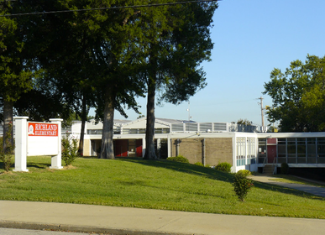
Contact
Laura Koch
kochlf@scsk12.org
Lauren Williams
williamsL27@scsk12.org
Ryan Warren
warrenrb@scsk12.org

Slide 25
Questions??

